Slide 1
Thermal equilibrium
Heating by radiation field in photo case
In coronal case external process sets temperature
Cooling is anything that converts kinetic energy into light that escapes

Slide 2
Two types of lines
Recombination AGN3 sec 4.2
  q~1e-13 cm³ s⁻¹
  Mainly H, He
Collisionally excited AGN3 3.5
  q~1e-9 cm³ s⁻¹
  Heavy element

Slide 3
[O III]
AGN3 Fig 3.1

Slide 4
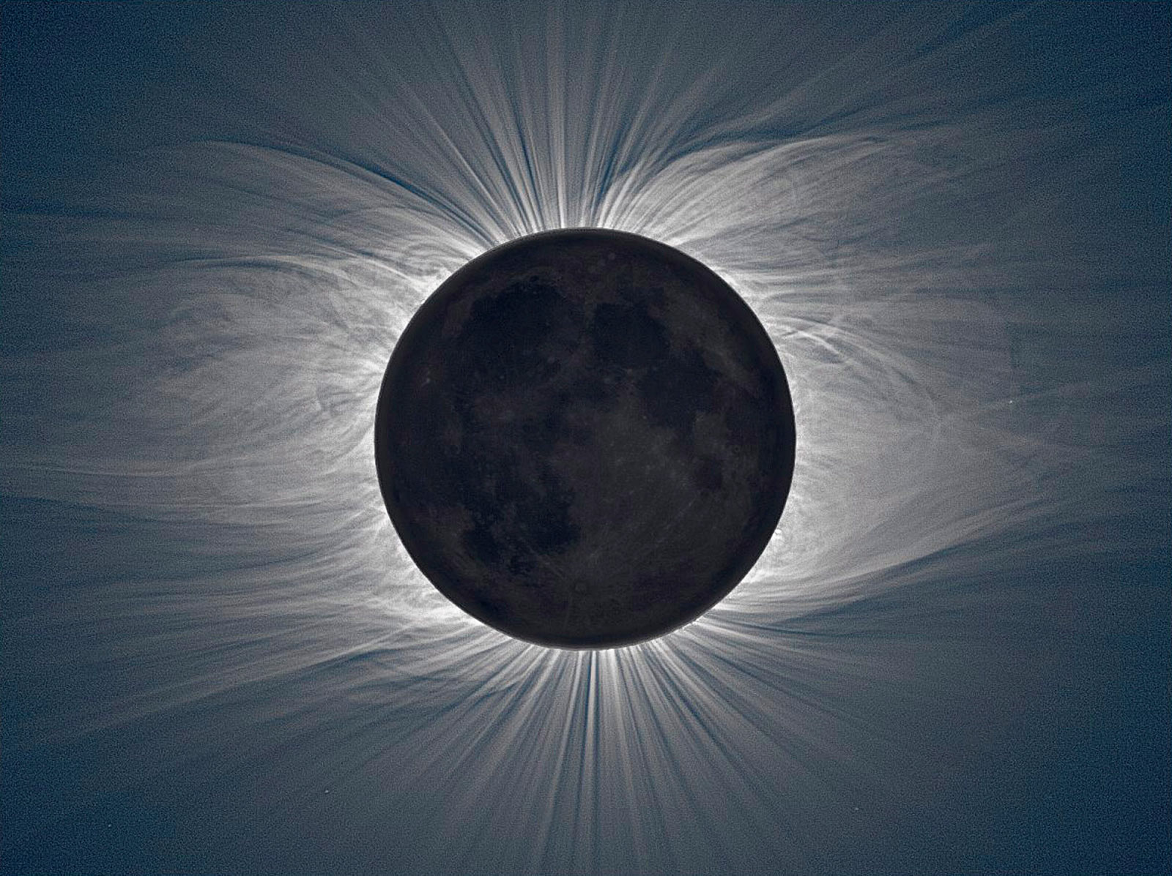
Coronal equilibrium
Mechanical energy sets kinetic temperature
“Coronal” command in Cloudy
Try several T,
plot SAVE
CONTINUUM
output

Slide 5
Various temperatures

Slide 6
Grid command – cooling function
Grid command Hazy 1 Chapter 18
  Carefully study temperature log rules, Sec 18.5
Coronal equilibrium command
Save cooling output
Plot cooling vs temperature
Notes:
Coronal 8 vary
grid 1 9 0.25 log

Slide 7
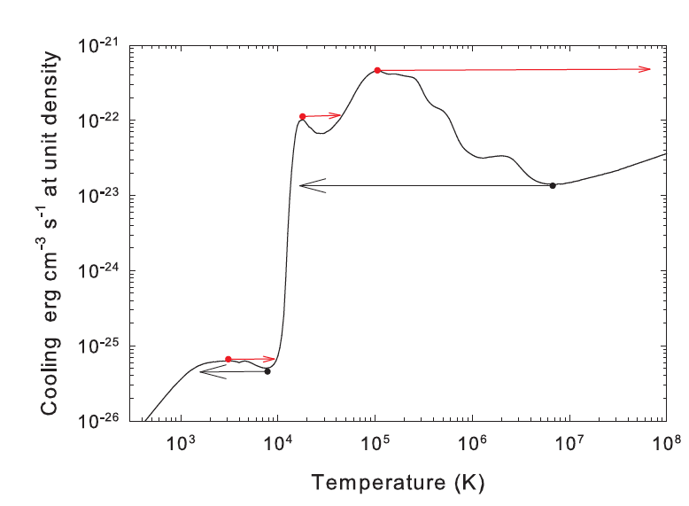
Dalgarno&McCray 1972 ARAA 10, 375
Ferland+09 MNRAS, 392, 1475

Slide 8
Dalgarno&McCray ARAA 10, 375
Ferland+09 MNRAS, 392, 1475

Slide 9
Dalgarno&McCray ARAA 10, 375
Ferland+09 MNRAS, 392, 1475

