Slide 1
Minimum to run Cloudy
Must specify
  SED – shape of the radiation field
  Flux of photons per unit area
  Gas density
May specify
  Gas composition, grains (grain-free solar by default)
  Gas equation of state (often constant density)
  Stopping criterion, often physical thickness

Slide 2
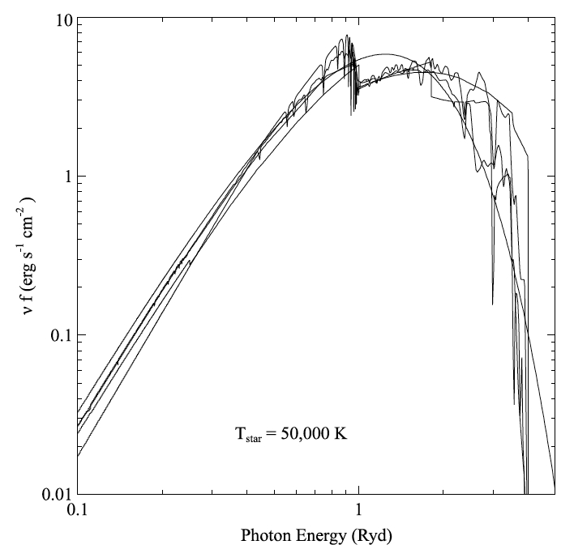
Parameters – the SED
Quick start guide Chapter 5
Hazy 1, Chapters 4, 6
Can be specified as a
fundamental shape
such as a blackbody
Generally entered as
table of points

Slide 4
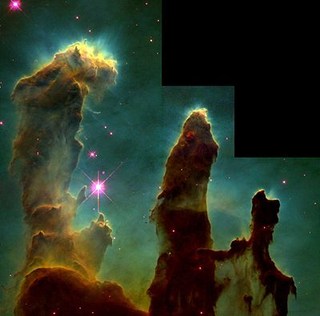
SED brightness – the intensity case
Specify ϕ(H) – photons per
unit area
  The “intensity case”
  predicts emission per unit
  area
  Inner radius of cloud does
  not need to be specified
Notes:
Show cartoon of cylinder viewed edge on, ray through it, limb brightening

Slide 5
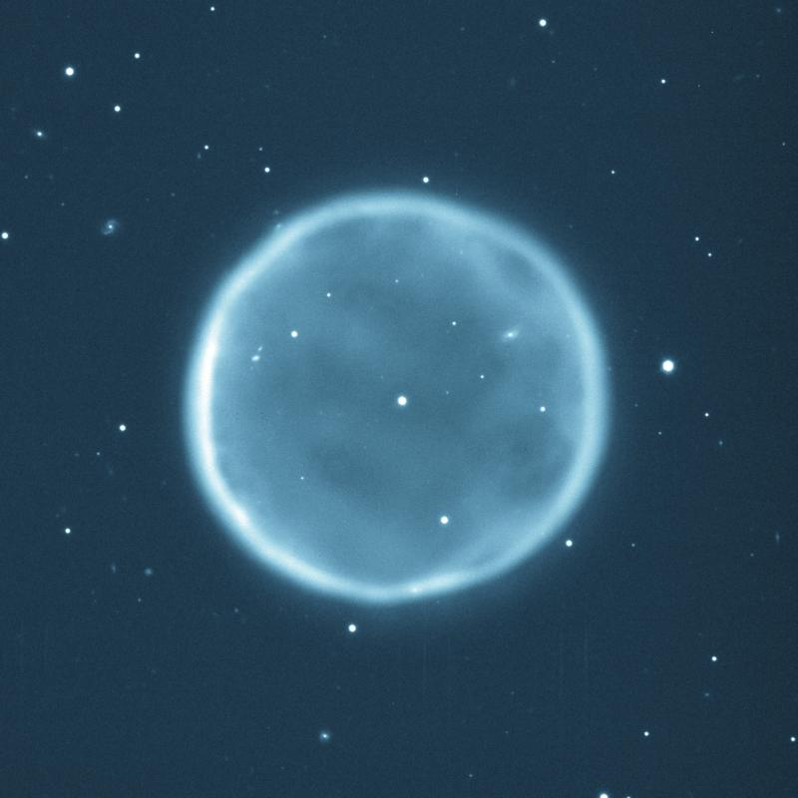
SED brightness – the luminosity case
Specify Q (H) – photon luminosity
  Inner radius of cloud must
  be specified, since
  φ(H) = Q(H) / 4π r²
  predicts emission line
  luminosities

Slide 6
The “main output”
The *.out file created when code is executed
  QSG 7.1 & Hazy 2 Chapter 1
Gas & grain composition
Physical conditions in first and last zone
Emission line spectrum
Mean quantities
Cloudy is designed to be autonomous and self aware
Will generate notes, cautions, or warnings, is conditions are not appropriate.

Slide 7
“Save” output
Requested with various “save” commands
  Hazy 1 Section16.35 and later
The main way the code reports its results

Slide 8
The Orion H II Region
Based on Baldwin, Ferland, Martin+91 model
Layer in hydrostatic equilibrium
Only the H II region (so faster)
Cloudy / tsuite / auto / orion_hii_open.in

Slide 9
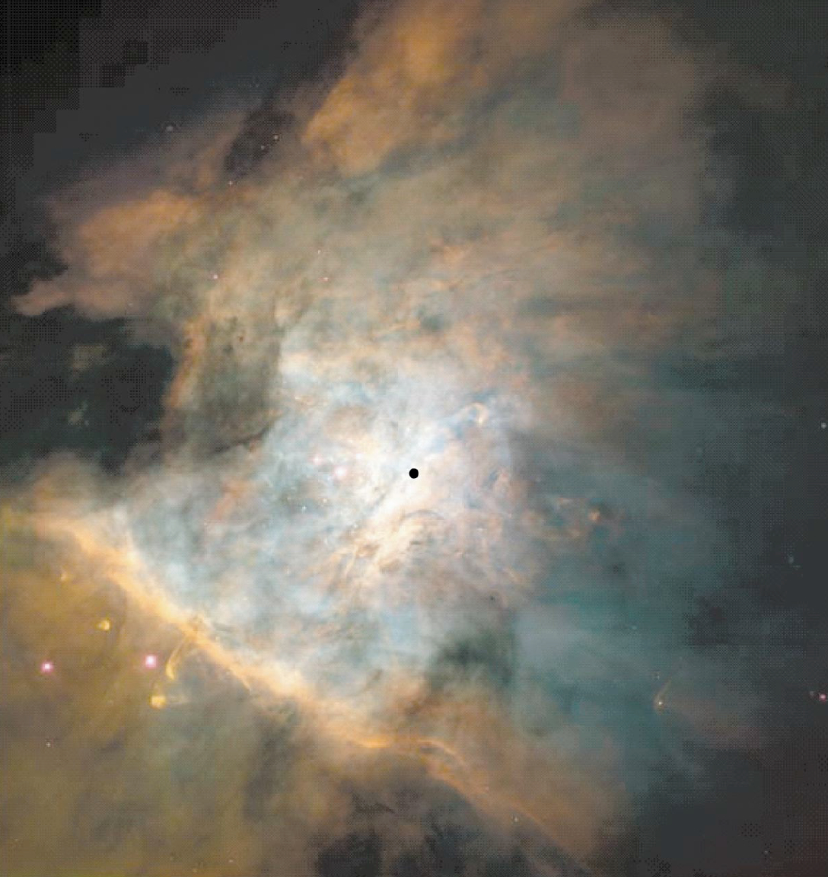

Slide 10
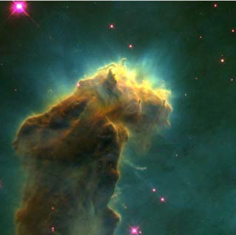

Slide 11
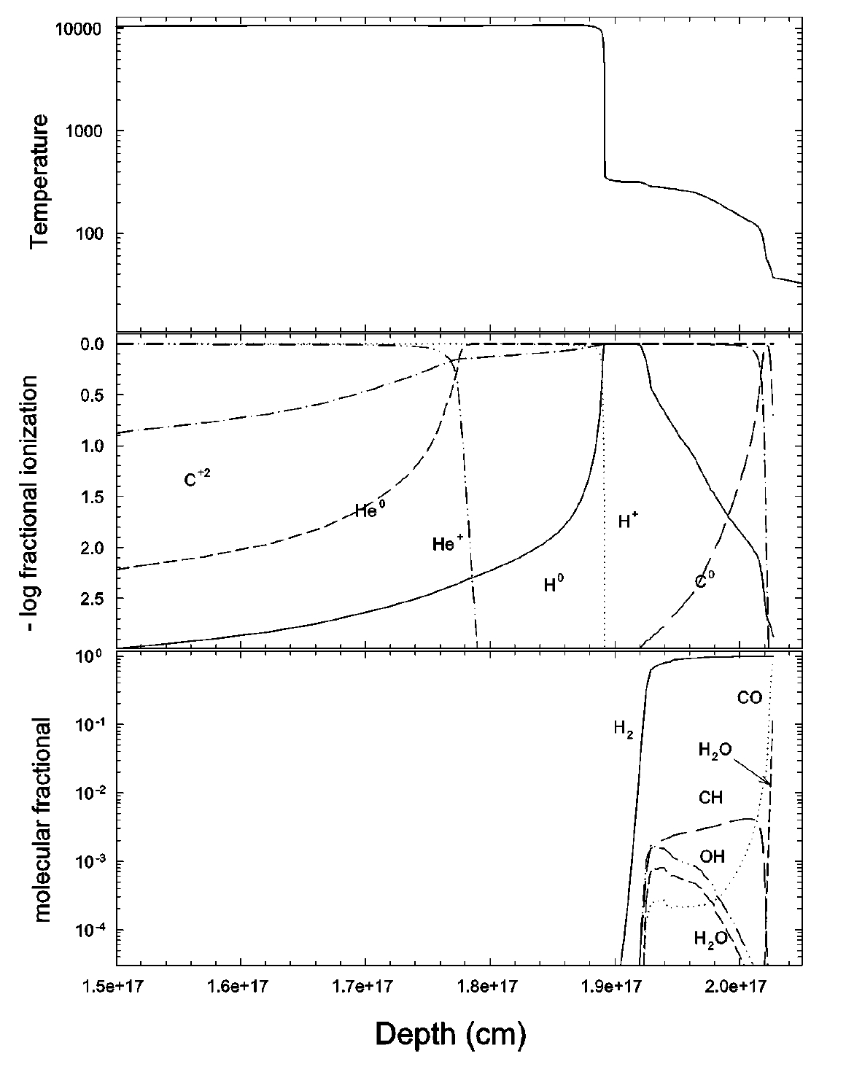

Slide 12
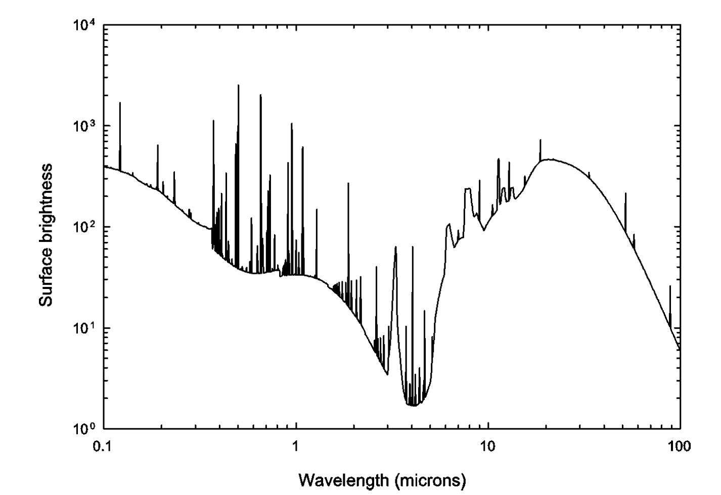
Notes:
Predicted spectrum
Lots of emission lines
PAH emission
Thermal dust emission
From study of spectra
Find abundances, -> dust survives in ionized gas because Al, Ca, Fe, Si abundances are depleted (PAHs are destroyed)

Slide 13
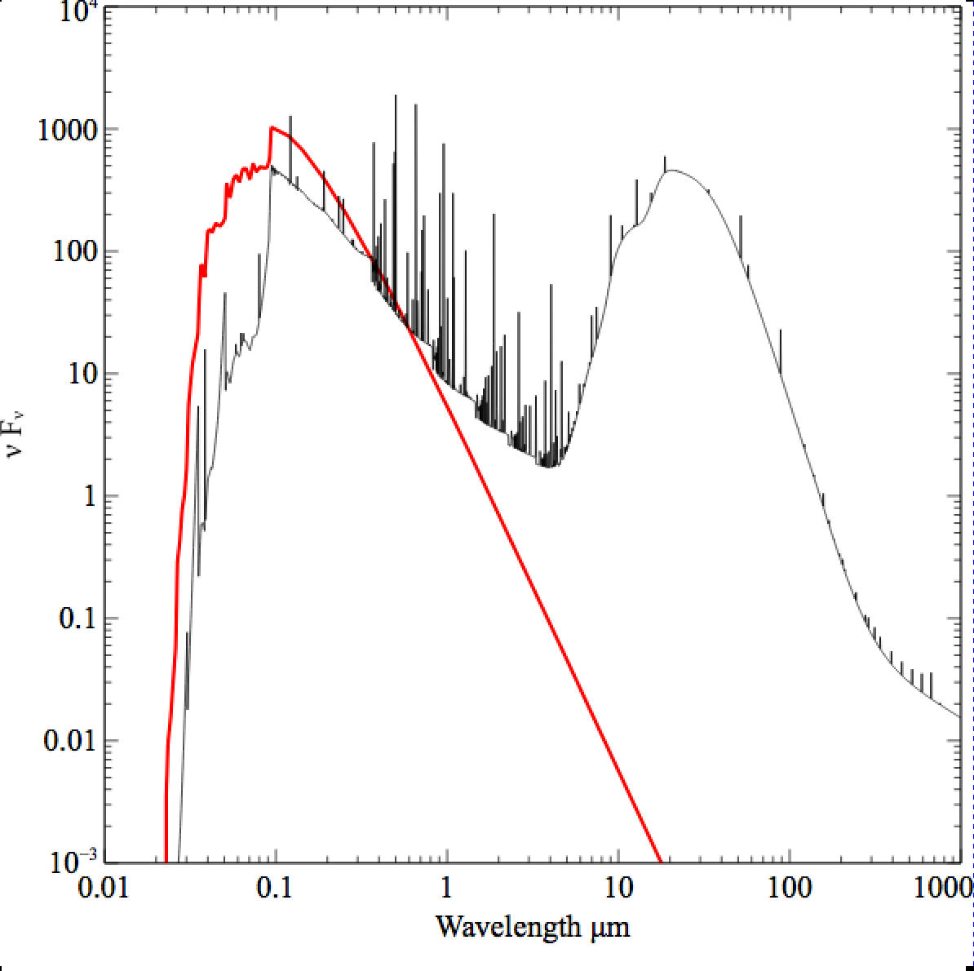

Slide 14
Parameters – the SED
Quick start guide Chapter 5
Hazy 1, Chapters 4, 6
Can be specified as a fundamental shape such as a blackbody
Generally entered as table of points

Slide 15
SED brightness – the intensity case
Specify ϕ(H) – photons per
unit area
  The “intensity case”
  predicts emission per unit
  area
  Inner radius of cloud does
  not need to be specified
Notes:
Show cartoon of cylinder viewed edge on, ray through it, limb brightening

Slide 16
SED brightness – the luminosity case
Specify Q (H) – photon luminosity
  Inner radius of cloud must
  be specified, since
  ϕ(H) = Q(H) / 4π r²
  predicts emission line
  luminosities

Slide 17
Cloud density
“hden” command
Constant density by default
Other equations of state possible

Slide 18
Composition
Solar, no grains, by default
Other standard mixes possible

Slide 19
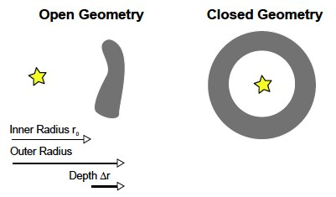
Open vs closed geometry Hazy 2.3

Slide 20
Covering and filling factors
Covering factor
  AGN3 …
Filling factor, how to do clumps
  AGN3, hazy1

Slide 21
Strömgren length

Slide 22
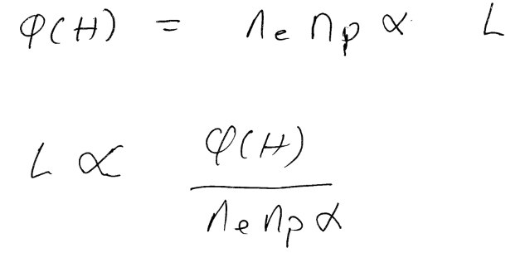
Strömgren length
Number of ionizing photons entering layer
is balance by
number of recombinations along it

Slide 23
Matter vs radiation bounded
SL is for radiation bounded, there is an I front
Show Abell sphere – matter bounded,
So phi(H) > SL equation
Show pics, give section in AGN3

Slide 24
Beyond the H⁺ layer
Little H⁺ ionizing radiation gets
past the H⁺ layer
Deeper regions are atomic or
molecular
Also cold and produce little visible
light
Large extinction due to dust

Slide 25
Clumping
Filling factors, when clumps smaller than photon scale length
  Osterbrock & Flather 1957
Add together distinct clouds, when clumps larger than photon scale length
  Balwin+ 1995 ApJ 455, L119+

Slide 26
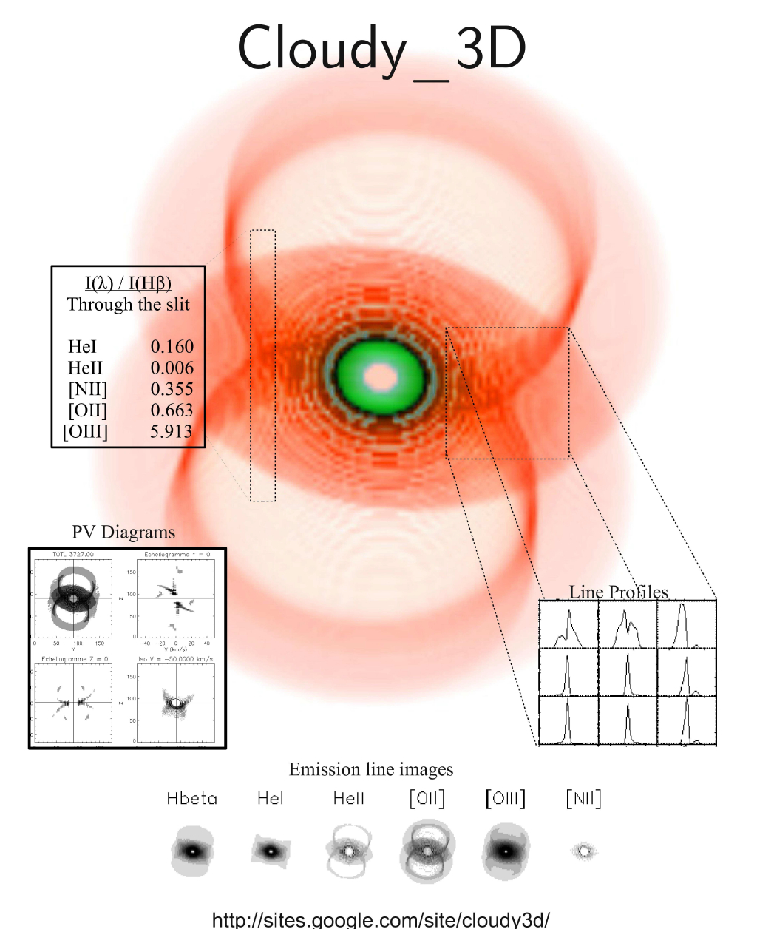
Volume elements in larger structures

