Slide 1
Cloudy: plasma & spectral simulations
Accurate simulation of physical processes at the atomic & molecular level
“universal fitting formulae” to atomic processes fail when used outside realm of validity, and are not used
Assumptions:
energy is conserved
(usually) atomic processes have reached steady state
Limits:
Kinetic temperature 2.7 K < T < 10¹⁰ K
No limits to density (low density limit, LTE, STE)
Radiation field 10 m to 100 MeV

Slide 2
Simultaneous solution of
Ionization lightest 30 elements
From ionization balance equations
Chemistry ~140 molecules
Large network based on UMIST
Gas kinetic temperature
Heating and cooling
Grain physics
Charging, CX, photoejection, quantum heating, temperature & temperature fluctuations
The observed spectrum
Radiative transport

Slide 3
Cloudy and its physics
Osterbrock & Ferland 2006, Astrophysics of Gaseous Nebulae and Active Galactic Nuclei, 2nd edition (AGN3)
Ferland+2013, Rev Mex 49, 137, The 2013 Release of Cloudy
Ferland 2003, ARA&A, 41, 517, Quantitative Spectroscopy of Photoionized Clouds
Links at http://cloud9.pa.uky.edu/~gary/cloudy/CloudySummerSchool/CloudyBackgroundInfo.html

Slide 4
Some applications to astronomy
Hamann & Ferland, ARA&A, 37, 487, Elemental Abundances in Quasistellar Objects: Star Formation and Galactic Nuclear Evolution at High Redshifts
Ferland 2001, PASP, 113, 41, Physical Conditions in the Orion H II Region
And the ~200 papers that cite its documentation each year

Slide 5
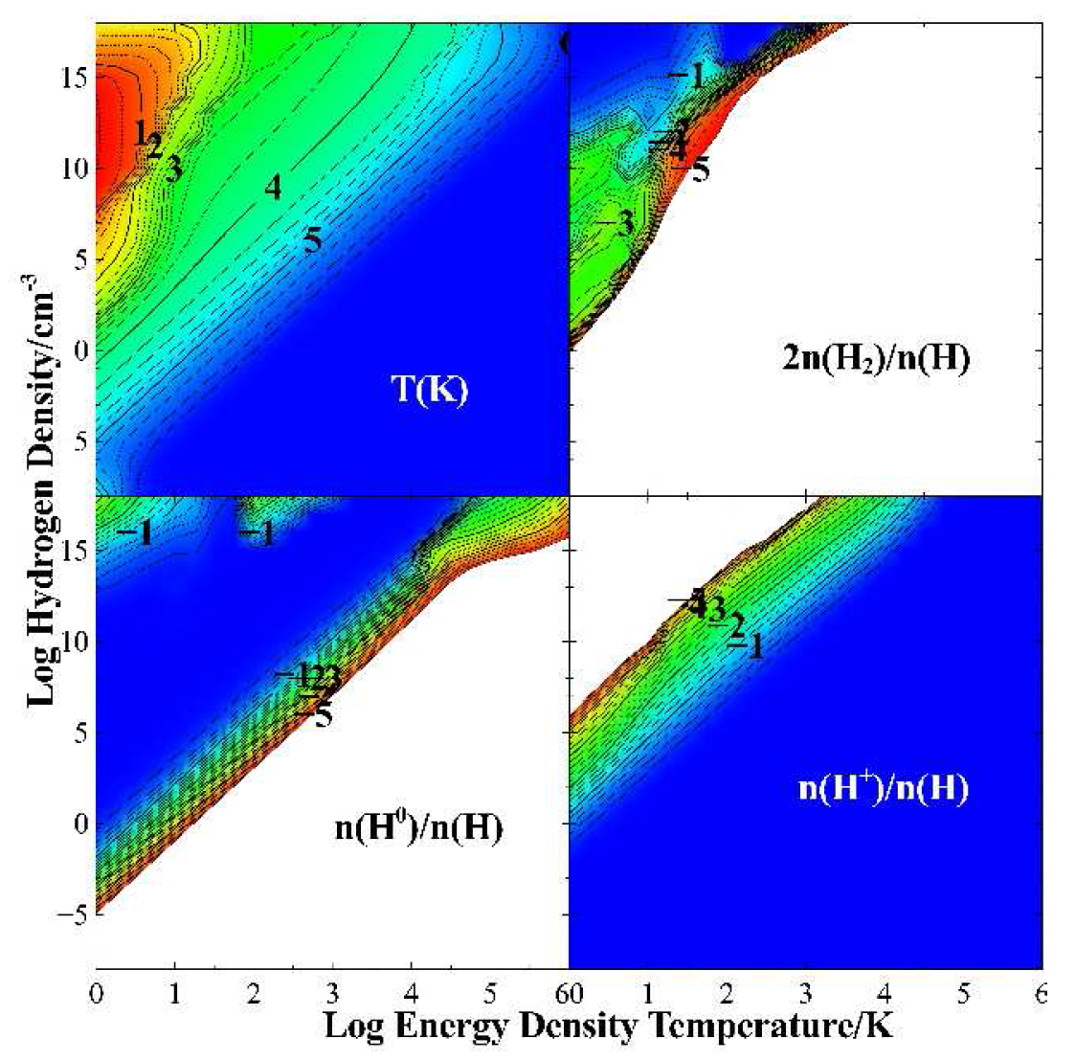

Slide 6
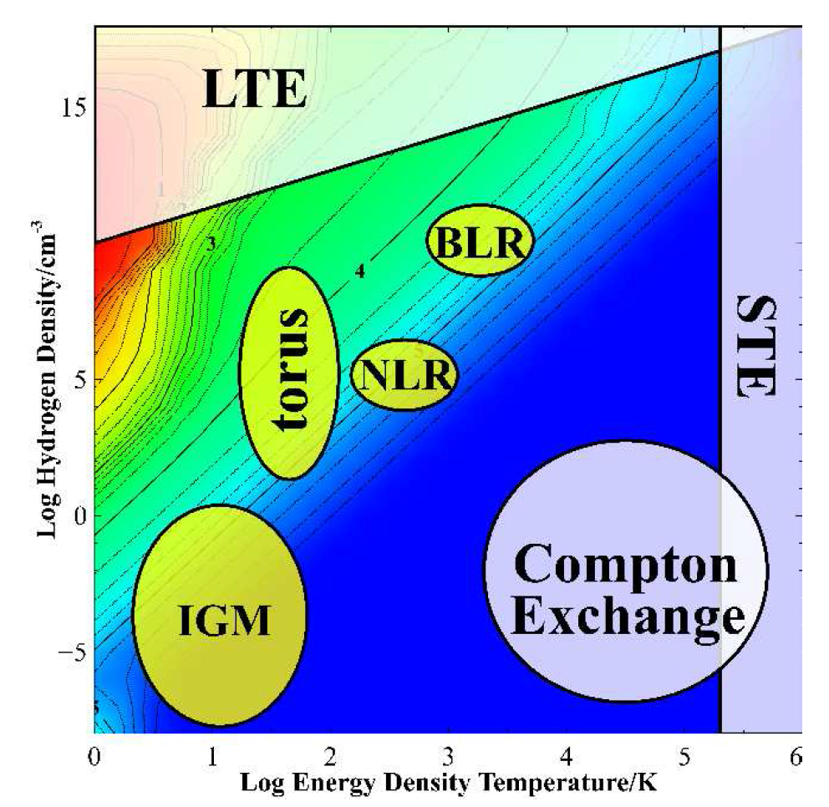

Slide 7
Open source since 1978
All versions, all source, all data, on svn at nublado.org
You are most welcome to help!

Slide 8
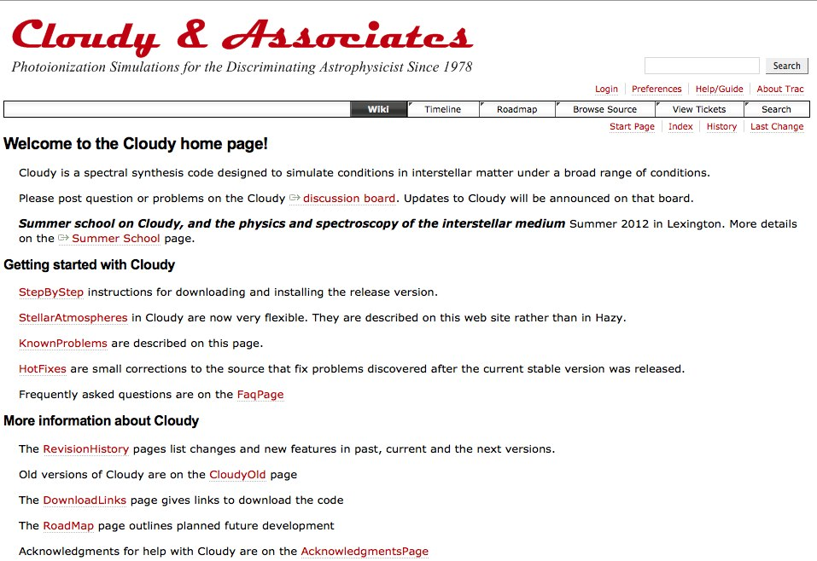
https://www.nublado.org/
Notes:
Lots of information about Cloudy

Slide 9
https://www.nublado.org/
Notes:
How to download

Slide 10
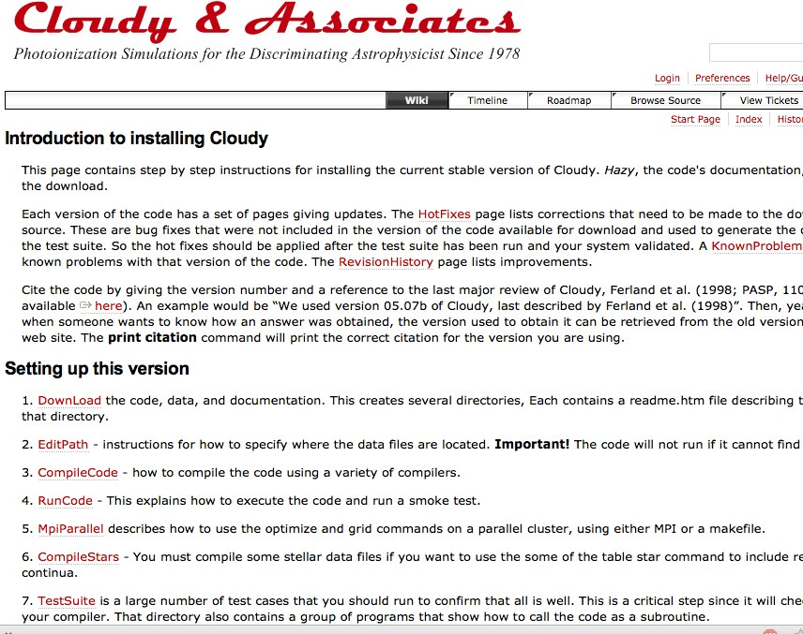

Slide 11
https://www.nublado.org/

Slide 12
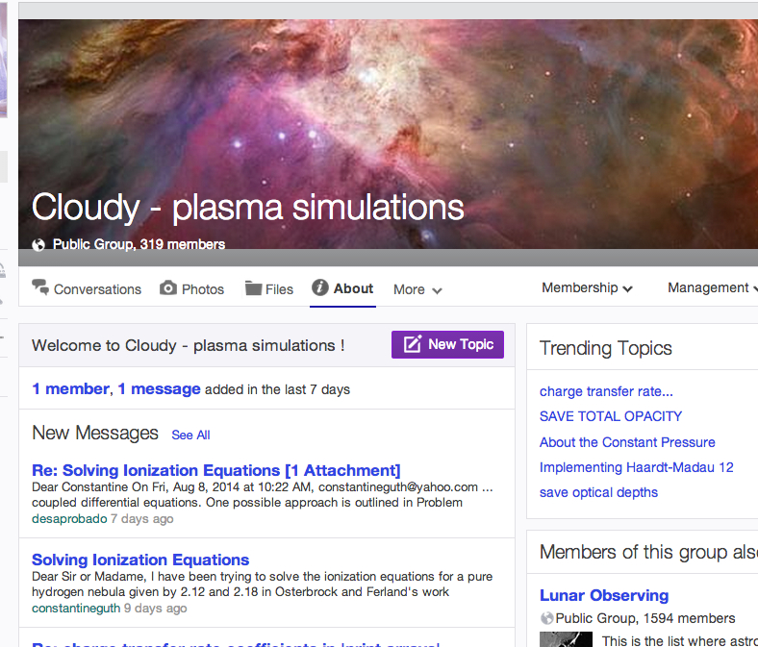
Where to go for help
https://groups.yahoo.com/neo/groups/cloudy_simulations/info

Slide 13
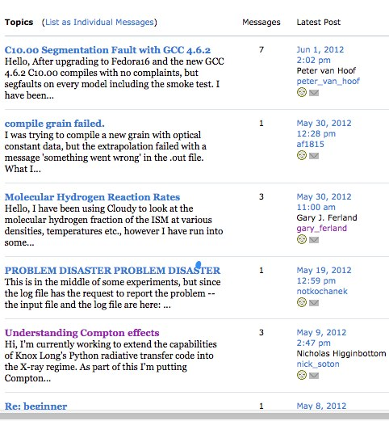

Slide 14
Documentation
Quick start guide
Hazy 1, all commands
Hazy 2, description of output, comparison with observations
Hazy 3, not compiled, badly out of date, some physics is described there

Slide 16
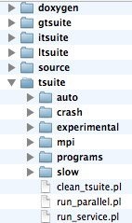
The test suite
Fully tests the code after any changes
“Monitors” allow automatic comparison of current with previous results
Provides examples of how to use Cloudy
But may include extraneous commands for testing
Useful examples of how to set up a simulation

Slide 17
Running cloudy
“run” file contains path-to-cloudy.exe -r $
If file “model.in” contains input, then
run model &
Produces output “model.out”
Smoke test – create test.in containing the word “test”

